Slide 1
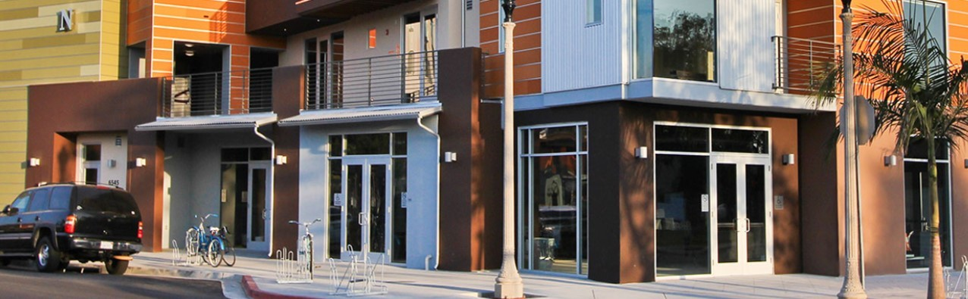




The Aluminum Advantage in Fenestration
This Online Learning Seminar is available through a professional courtesy provided by:
All Weather Architectural Aluminum
777 Aldridge Rd, Vacaville,
CA 95688, United States
Tel: 707-52-1600
Fax:707- 452-1616
Toll-Free: 800-680-5800
Email: PLEASE SUPPLY
Web: https://www.allweatheraa.com/
START
©2020 All Weather Architectural Aluminum. The material contained in this course was researched, assembled, and produced by All Weather Architectural Aluminum and remains its property. Questions or concerns about the content of this course should be directed to the program instructor. This multimedia product is the copyright of AEC Daily.
powered by

Slide 2
The Aluminum Advantage in Fenestration
To ensure the current status of this course, including relevant association approvals, please view the course details here.
The American Institute of Architects
Course No. AECXXX
This program qualifies for 1.0 LU/HSW Hour
Course Expiry Date: MM/DD/YYYY
AEC Daily Corporation is a registered provider of AIA-approved continuing education under Provider Number J624. All registered AIA CES Providers must comply with the AIA Standards for Continuing Education Programs. Any questions or concerns about this provider or this learning program may be sent to AIA CES (cessupport@aia.org or (800) AIA 3837, Option 3).
This learning program is registered with AIA CES for continuing professional education. As such, it does not include content that may be deemed or construed to be an approval or endorsement by the AIA of any material of construction or any method or manner of handling, using, distributing, or dealing in any material or product.
AIA continuing education credit has been reviewed and approved by AIA CES. Learners must complete the entire learning program to receive continuing education credit. AIA continuing education Learning Units earned upon completion of this course will be reported to AIA CES for AIA members. Certificates of Completion for both AIA members and non-AIA members are available upon completion of the test.

Slide 3

AEC Daily Corporation has met the standards and requirements of the Registered Continuing Education Program. Credit earned on completion of this program will be reported to RCEP at RCEP.net. A certificate of completion will be issued to each participant. As such, it does not include content that may be deemed or construed to be an approval or endorsement by the RCEP.

Slide 4
How to Use This Online Learning Course
To view this course, use the arrows at the bottom of each slide or the up and down arrow keys on your keyboard.
To print or exit the course at any time, press the ESC key on your keyboard. This will minimize the full-screen presentation and display the menu bar.
Within this course is a test password that you will be required to enter in order to proceed with the online test. Please be sure to remember or write down this test password so that you have it available for the test.
To receive a certificate indicating course completion, refer to the instructions at the end of the course.
For additional information and post-seminar assistance, click on any of the logos and icons within a page or any of the links at the top of each page.

Slide 5
Purpose and Learning Objectives
Purpose:
Aluminum production has recently decreased its environmental footprint dramatically and aluminum window extrusion technology has advanced considerably to make aluminum one of the most sustainable materials and aluminum windows top performers. This course reviews the production improvements of aluminum and aluminum windows, the factors relevant to good window design, and how aluminum thermally broken window extrusions address building energy, occupant health and well being, and sustainability.
Learning Objectives:
At the end of this program, participants will be able to:
select or design aluminum window extrusions to deliver the best window performance
recall the sustainable attributes of aluminum when selecting window frame material
integrate superior frame technology with glazing strategies to create energy efficient aluminum windows, and
improve indoor environments with reduced window air and water leakage, and increased daylight.

Slide 6
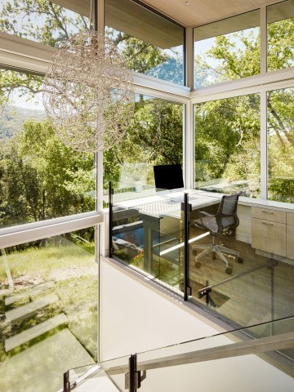
Contents
Getting To Know Today’s Aluminum Better
Window Performance Considerations
Window Performance Standards
Environmental Product Declarations (EPDs) and Green Building Certification
Case study: 1101 Connecticut Street, San Francisco
Summary and Resources

Slide 7
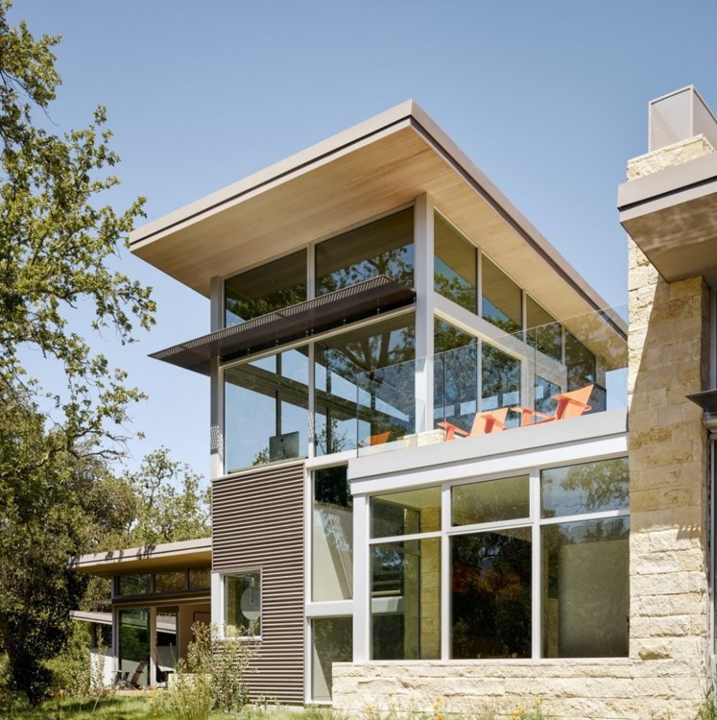
Getting To Know Today’s Aluminum Better
This section highlights some of the history and recent advancements made by the aluminum industry.
The following section will explore the various considerations a designer or specifier should use in regards to window selection.
The third section gives some of the specific standards and technologies which help designers determine the appropriate performance level for these various considerations.
The fourth section outlines how the use of aluminum windows can contribute to higher building certification ratings and the fifth section describes an affordable housing project which used customized aluminum window frames as part of its strategy to achieve LEED® platinum certification.
“LEED® is the preeminent program for the design, construction, maintenance and operations of high-performance green buildings.”

Slide 8
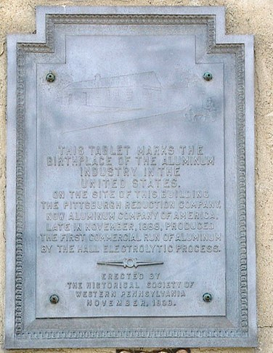
A Brief History of Aluminum Usage
The first aluminum products are believed to be medals created during the reign of Napoleon 111 (approx.1852) who also served special guests at his state dinners on aluminum plates.
In 1887 Austrian engineer Karl Josef Bayer developed a chemical process to extract alumina from bauxite, the third most plentiful ore on earth. The basic process is still used today. In 1888 the Pittsburgh Reduction Company launched the first smelting plant in North America.
Aluminum is now produced with far less energy and at much less cost. In the early 1920’s, for example, the cost of aluminium was reduced by 80% because of innovations in the production process.
Tablet commemorating birthplace of aluminum industry
Painatoke CC BY-SA 2.0 via wikimedia

Slide 9
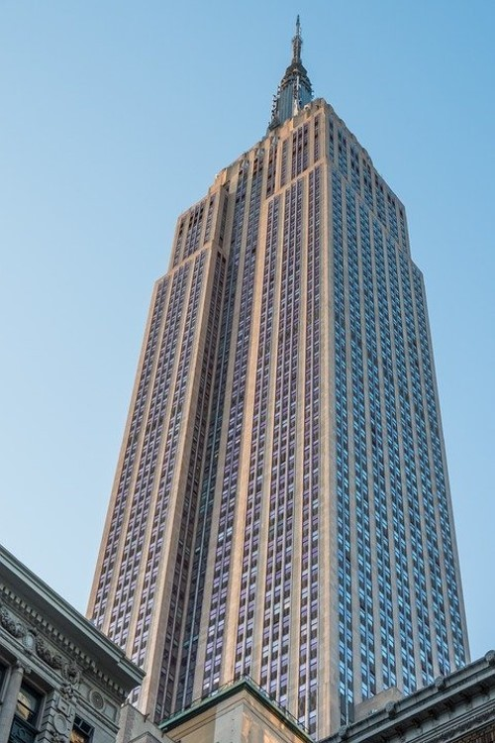
A Brief History of Aluminum Usage
The Empire State Building, built in 1931, was the first building to use aluminium both in the basic structure and interior. In 1994, the 5,460 original badly deteriorated steel window frames were replaced with aluminum frames.
During a major energy retrofit in 2011 all of those aluminum frames were still in excellent condition and were kept in place and just the glazing was upgraded.

Slide 10
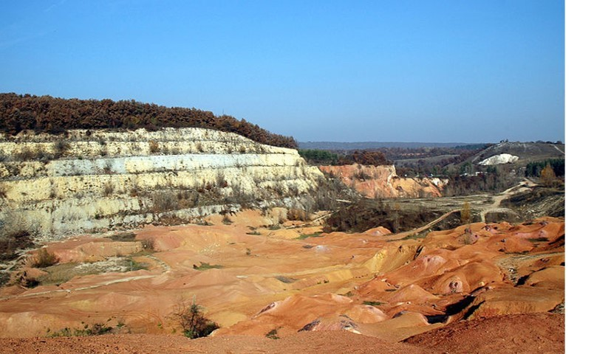
Environmental Rehabilitation
Known bauxite deposits are sufficient to support the current production rate of aluminium for another 300 years.
Open cast methods are usually used and great care is taken to restore and re-vegetate mine sites. (image).
Globally, the area rehabilitated each year equals the area being mined.
Former bauxite mine
VargaA CC BY-SA 4.0 via wikipedia

Slide 11
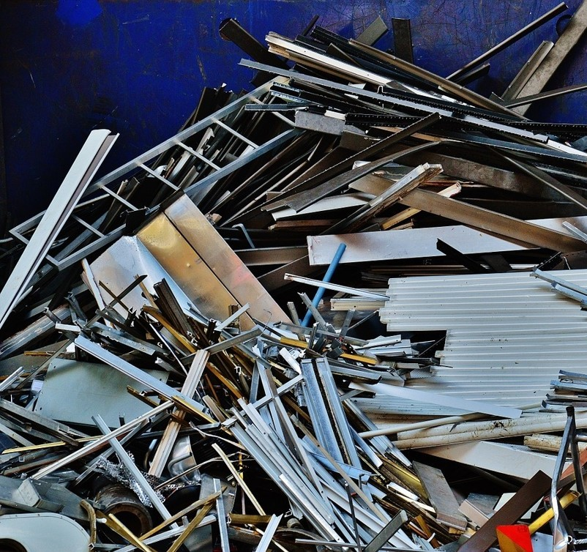
Recycling Aluminum
In North America, it is estimated that at least 85% of all aluminum shipped to the construction sector is still in productive use today. 12% has been recycled in the form of end of life scrap/resource and only 3% has been lost in the natural environment.
Annual benefits of recycling include saving about 70 million barrels of crude oil, 2.4 million acres of land, 45 million tons of fresh and sea water usage, 7.5 million tons of solid waste and 27 million tons of CO₂ .

Slide 12
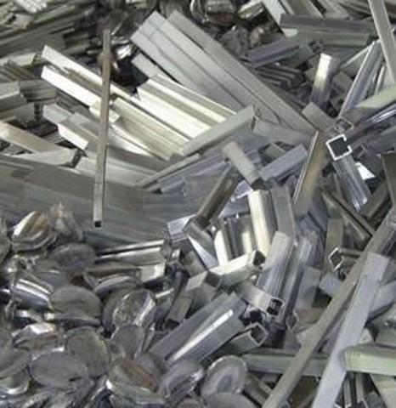
Recycling Aluminum
Aluminum is 100% recyclable and retains all of its properties indefinitely. Recycled aluminum production requires only 8% of the energy and creates just 8% of the emissions of primary production. A 10% increase in recycling rates decreases primary energy demand and greenhouse gas emissions by 15%.
Aluminum is one of the only materials in the consumer disposal stream that more than pays for the cost of its own collection.
A 2004 study by Delft University of Technology concluded that roughly 95% of the aluminum collected from buildings is recycled.

Slide 13
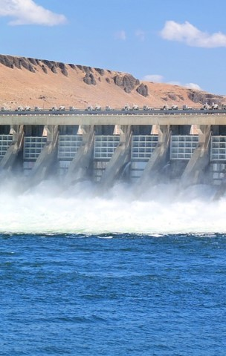
Aluminum Energy Usage Reductions
Energy demand for primary metal production has been reduced 17% and GHG emissions have been reduced 42% in the previous two decades. For secondary metal production energy demand has been reduced 58% and GHGs have been reduced 65%.Today’s electric power consumption per ton is about 50% of what it was 50 years ago and 7% lower than 20 years ago.
A life cycle assessment (LCA) study by the Aluminum Association reviewing the 2010 production year of 25 companies representing 95% of US production found that primary production energy demand had decreased 11% since 2005 and 25% since 1995.The industry's carbon footprint has dropped 19% since 2005 and nearly 40% since 1995 and it now uses more renewable hydropower than ever before; 75% versus 63% in 1991.
Aluminium incorporated into building design is now likely to save much more energy throughout the life of the building than was consumed in its initial manufacture and aluminum is now more sustainable than at any time in history.

Slide 14

Beneficial Attributes of Aluminum
The beneficial attributes of aluminum which are noted on the following slides give manufacturers and designers a wide range of options for product innovation and process improvements and the creation of high performance windows.

Slide 15
Beneficial Attributes of Aluminum
Aluminum is:
Lightweight and strong: Aluminum’s high strength-to-weight ratio makes it especially useful as a structural material. It weighs 65% less than steel, is 34 times stronger than vinyl, 43 times stronger than wood, and, when appropriately alloyed and treated, can be stronger than some steels, with ultimate tensile strengths as high as 80,000 psi to 90,000+ psi. Because aluminum structures are light they also reduce substructure costs significantly. Modern skyscrapers could not be built without aluminum.
Corrosion resistant and long-lasting: Aluminum naturally generates a protective oxide coating that resists corrosion. If this film is scratched or damaged, it reforms instantly. Different types of surface treatment can further improve this property.
Flexible: Aluminum can be made into any form, shape, size, and gage without compromising material integrity and performance.
Reflective: Aluminum is a good reflector of visible light and heat. That makes it an ideal material for reflecting sunlight and saving energy.
Impermeable: Aluminum has an excellent barrier function which keeps out air, light, and microorganisms.
Durable: Aluminum’s unique combination of strength and corrosion resistance makes it a particularly durable material.

Slide 16
Beneficial Attributes of Aluminum
Aluminum is also:
Non-Toxic: Aluminum is not adversely affected by steam sterilizing and cleaning and will not harbor bacteria or insects.
Safe: Aluminum building products and their surface treatments do not present a hazard to occupants or the surrounding environment.
Non Magnetic and Non-Sparking: Aluminum is non-magnetic and non-sparking. These properties make it a suitable material for applications where explosive vapor mixtures are present.
Electrically Conductive: Aluminum iand copper are the two common metals with electrical conductivity high enough to permit their use as an electrical conductor. Although aluminum’s conductivity is just 62% of that of copper, its light-weight can prove to be a great benefit; an aluminum conductor of equal current-carrying capacity weighs just half that of a copper conductor.
A Thermal Barrier and Conductor: Aluminum can act as both a good barrier against as well as a good conductor of heat.
Stiff: Aluminum has greater resistance to deformation than either wood or vinyl. It is 72 times more rigid than wood, and 23.2 times more rigid than vinyl.

Slide 17
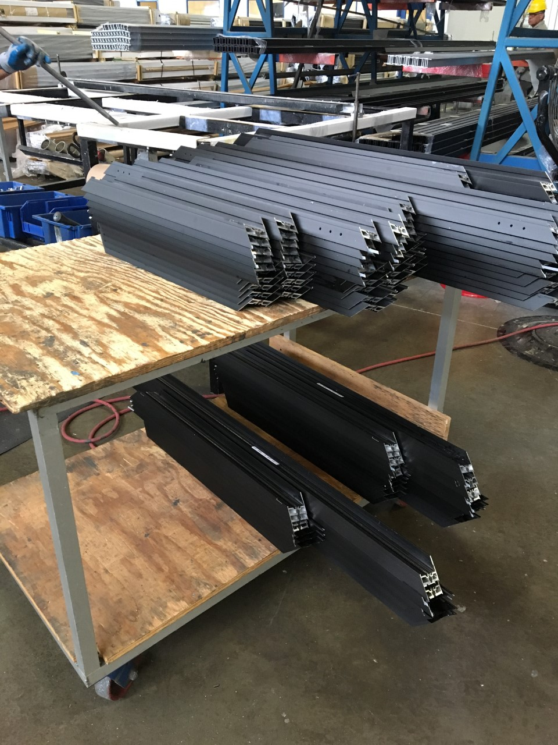
Aluminum Alloys
Aluminum alloys mix aluminum metal with other elements such as copper, magnesium, manganese, silicon, tin, and zinc. Aluminum alloys can be processed into different forms depending on the method of processing. The extrusion process, which forms longer, thinner, pieces (see image) is often used in the building industry, mostly for manufacturing doors and windows.
Aluminum alloys range from the 1000 series to the 7000 series. The 6000 series is most applicable to construction needs.
More specifically the 6060, 6063, 6061, and 6005A alloys, are, in general, preferable for less structural/more aesthetic applications with the latter two being more appropriate for structure.

Slide 18
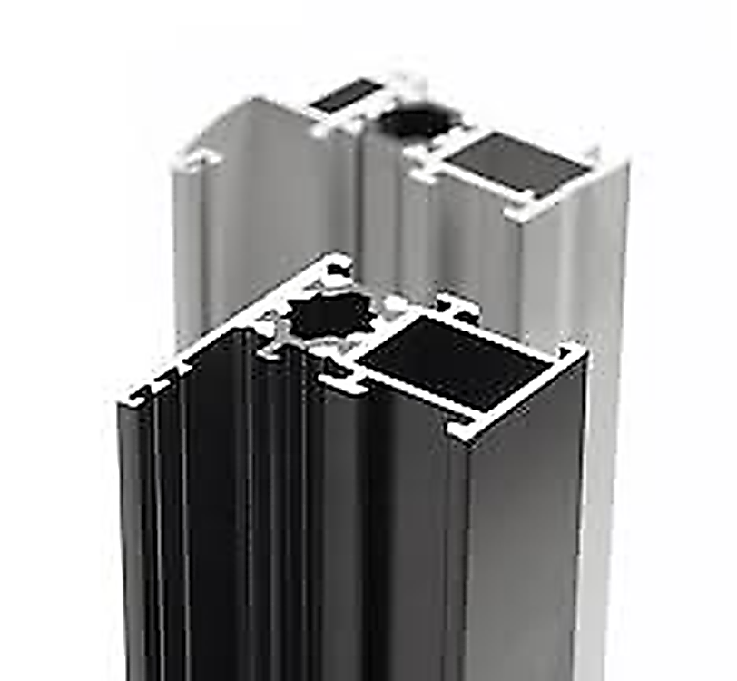
Aluminum Alloys
6060, and 6063 (and variants) cost less, but have better “extrudability” and surface finish. They suit light fixtures, furniture and entrance doors where yield and ultimate strength do not control the choice but where elastic buckling or deflection is critical. They have lower yield and ultimate strengths but perform similarly to 6061 and 6005A in buckling and deflection. Most aluminum has substantially the same modulus of elasticity, so a higher strength alloy may provide no deflection benefits. Applications that require a painted or anodized finish should use 6060/63.
6061 (and variants) alloys have high strength and higher cost, due to lower extrudability. They also have a poorer surface finish. 6005A is usually a better choice for many applications.
6005A is a newer alloy with high strength, moderate cost, and good extrudability and surface finish. It is much less “quench sensitive” than 6061 so extrusion is more reliably achieved without distortion from water quenching. This alloy is typically recommended for structural applications.
Extruded window frame sections connected by a thermal barrier.

Slide 19
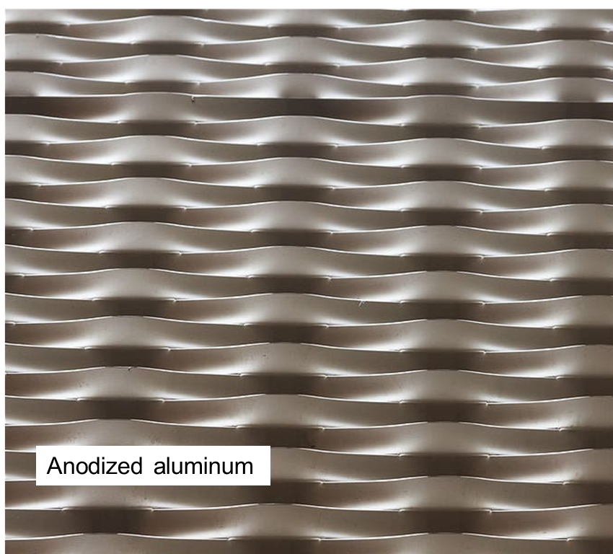
Aluminum Finishing
Because aluminum instantly forms a tenacious oxide film providing protection against corrosion after extrusion it has an advantage over steel where the iron oxide (rust) in steel can spall off to expose the metal to corrosion. For aluminum solutions, additional finishing is generally not needed except for aesthetic or severe service conditions (e.g. salt spray, heavy pollution).
When additional finishing is desired, anodizing or paint (either liquid or powder) is typically specified.
Anodizing is an electrochemical process that thickens and toughens the naturally occurring protective oxide. The resulting finish is the second hardest substance known to man after diamonds.

Slide 20
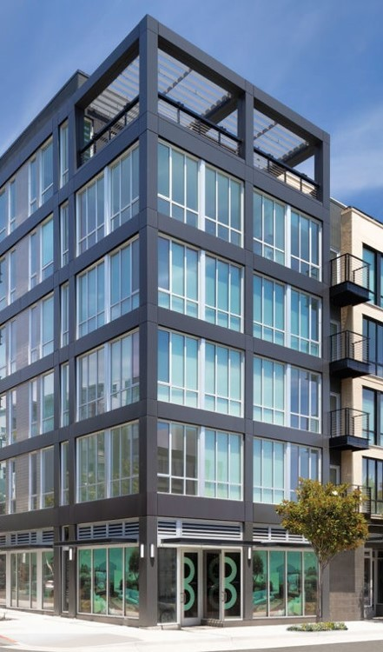
Aluminum Finishing
Liquid and powder coatings are multistep processes that coat and protect the aluminum. They protect the aluminum substrate and enhance its appearance. The processes range from a single coat liquid or powder to a four coat polyvinylidene fluoride (PVDF) liquid using a primer, barrier coat, color coat, and clear coat.
Powder coating provides excellent hardness and mar resistance while liquid coatings can utilize a protective primer and metallic topcoats to achieve many unique appearances.
Fluoropolymer systems have been the first choice for curtain walls for many years and they are still considered the premier system for this application.

Slide 21
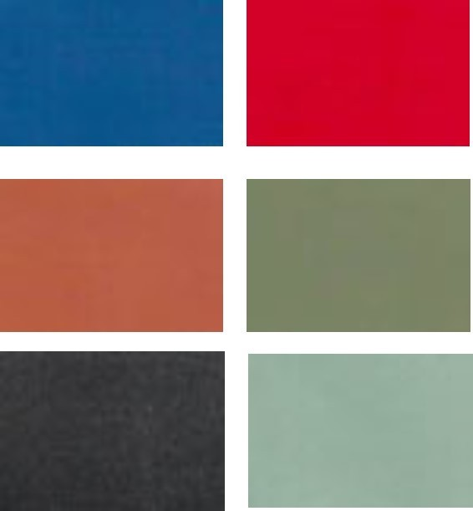
Aluminum Finishing
Mechanical finishing, such as brushing or sand‐blasting, is also employed occasionally. Most extruders either have in‐house paint and/or anodizing capabilities, or finishing service relationships that facilitate a finished and fabricated component.
American Architectural Manufacturers Association (AAMA) Specifications 2603, 2604, or 2605 are generally used to define paint finish performance and parameters, while AAMA 611 Class l or Class ll specifications are used to define anodizing.
The images to the right are just a few of the many many colors that can be used to finish aluminum.

Slide 22
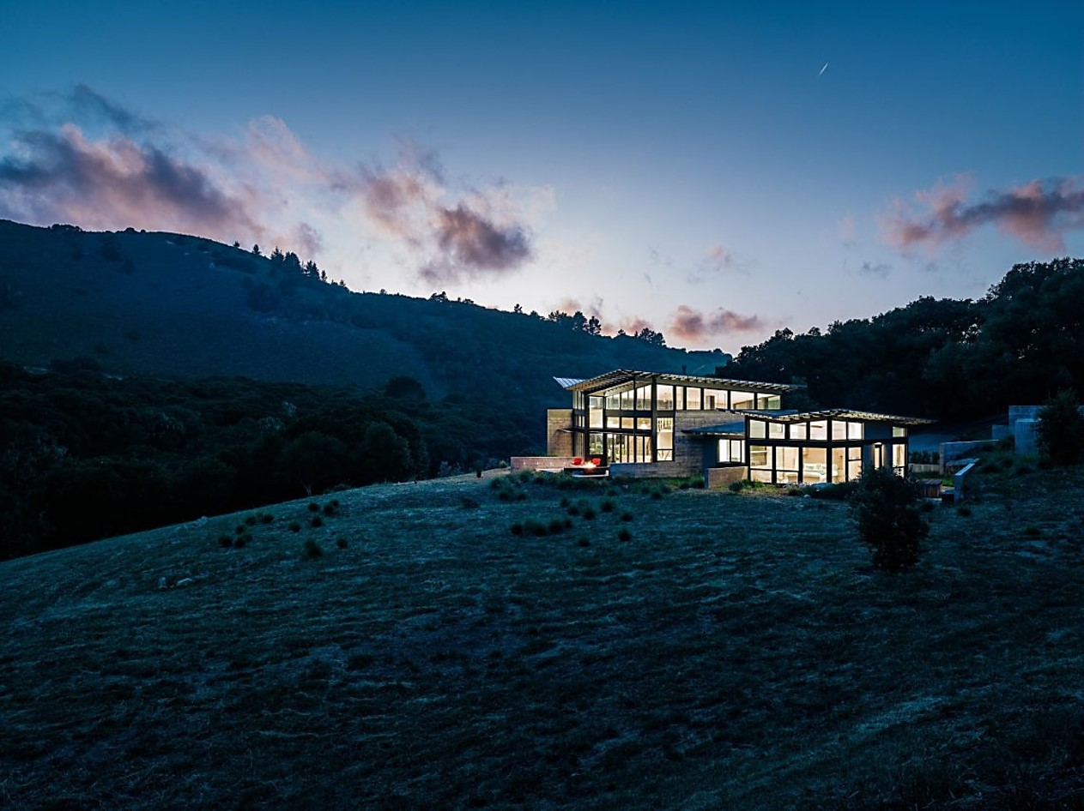
Window Performance Considerations

Slide 23
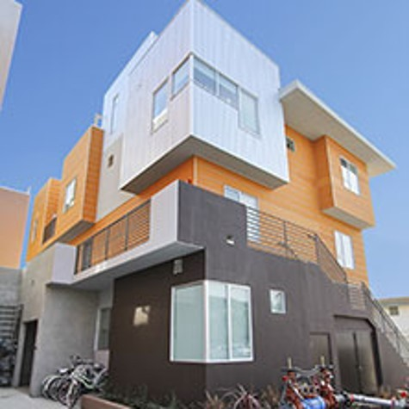
Window Performance Considerations
This section overviews the main window performance features that must be considered when designing windows.

Slide 24
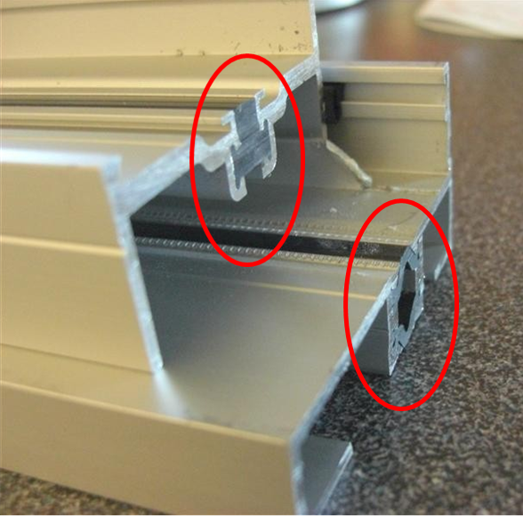
Thermal Performance
Because aluminum is a good conductor of heat, aluminum frames must be equipped with a thermal barrier that prevents heat from flowing from either inside to outside or vice versa depending on the climate, time of year, or time of day.
Thermal barriers made from resins are incorporated into the aluminum profiles in order to separate interior surfaces from the exterior ones. Barriers can have thermal conductivities as much as 500 to 1300 times lower than aluminum itself.
The thermal performance of the entire window assembly is heavily influenced by that of the frame. Window design is intended to achieve the best possible daylight transmission while minimizing heat transmission. Window frame conductivity is a function of the frame material, geometry, and design (e.g. thermal barriers in metal frames). The thermal resistance of an aluminum frame is determined more by the surface area of the frame than by the thickness or projected area, as is the case with other frame materials.

Slide 25
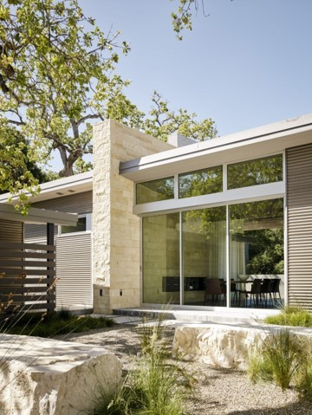
Thermal Performance
A window frame profile with a simple compact shape will perform better than a profile with many fins and undulations. Aluminum can be extruded into very thin, very efficient, frame profiles.
The current technology with standard thermal barriers has improved aluminum frame U-factors from roughly 2.0 to about 1.0. Innovative thermal break designs combined with changes in frame design have also created high performance frames that achieve U-factors even lower than 0.5.
U factors will be discussed later on in this course.

Slide 26

Moisture Resistance
The window industry has made significant advances in moisture resistance and has established the basic detailing principles as noted on the following slide that should be considered when selecting and designing windows.
Select proven and more sustainable window design techniques such as mitered corners stiffened by spline inserts, molded corner gaskets, vulcanized perimeter gaskets, and shop-applied perimeter collars, as opposed to sealants which can deteriorate over time.

Slide 27
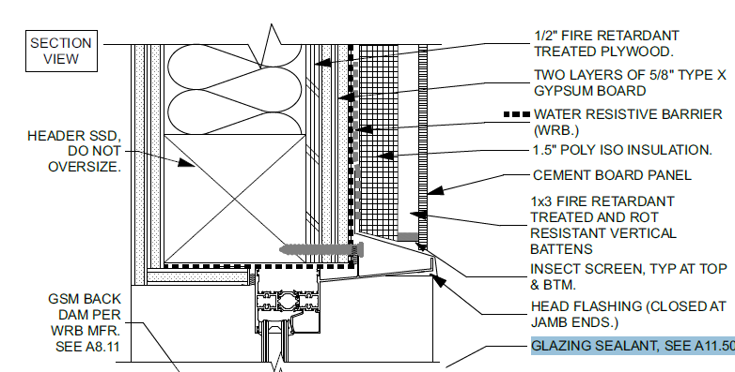
Moisture Resistance
Detail courtesy of vmwp architects and urban designers
Head Flashing: Use durable metal flashings. Window head flashings should slope to the exterior and be provided with an out-turned drip edge over the top of the window frame. They should extend several inches beyond the frame and be provided with watertight end dams. Head flashings should be sealed to both the inner face of the windows and the jamb flashings. Provide a minimum 4″ (100mm.) upturned leg and counter flash with wall waterproofing membrane adhered to the vertical leg of the metal flashing. For punched windows in openings that do not allow extension of the head flashing beyond the opening use dual sealant joints in lieu of head flashing to capture water and direct it to the jamb flashings

Slide 28
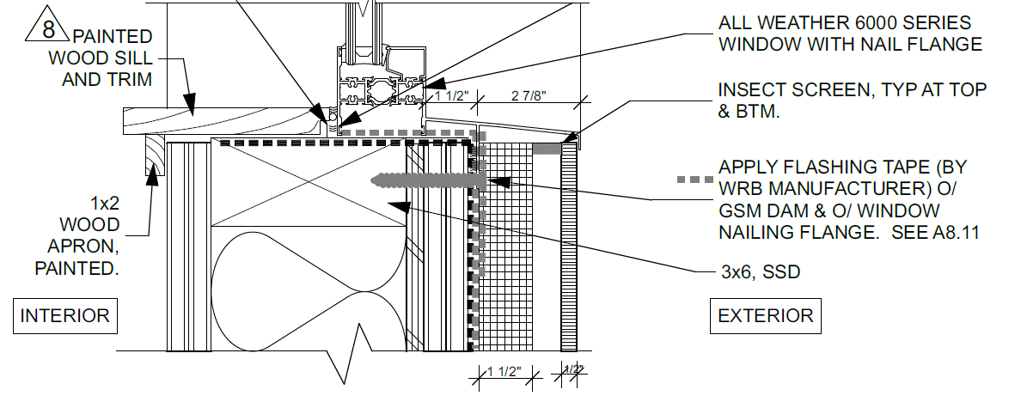
Moisture Resistance
GSM BACK DAMPER
GLAZING SEALANT
Detail courtesy of vmwp architects and urban designers
Sill Flashings: Provide sill flashings using durable metal (as opposed to flexible membranes) where they will be exposed. Slope flashings to exterior and provide an out-turned drip edge over face of the wall cladding. Provide an upturned leg (1″ or 25mm. min.) on the interior and watertight end dams. Do not penetrate the horizontal portion of flashing with fasteners. Fasten sill frames with an inboard attachment angle through the upturned leg of the sill flashing and into the inboard leg of the sill frame. Membrane flashings may be appropriate for concealed sill flashings which drain down into the wall cavity behind the cladding or onto sloped precast concrete or stone sills, but are less durable than metal.

Slide 29
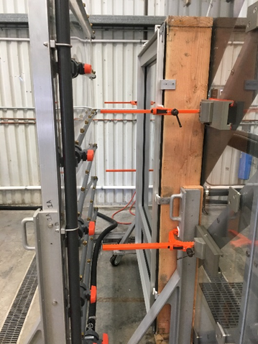
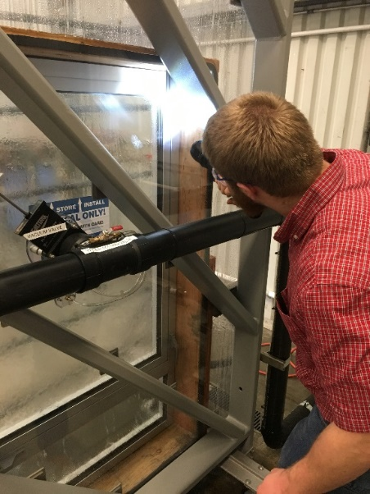
Water Penetration
ASTM E1105 is the Standard Test Method for Field Determination of Water Penetration of Installed Exterior Windows. It is important to understand the difference between lab testing which is to the point of failure and field testing which is intended to determine that the full assembly meets all ASTM and AAMA standards. It is also important to understand the purpose of the test, whether it is to ensure the assembly will perform or whether it is the intent to find the point of failure. Field testing is allowed at only 2/3 lab test limits. This is important as the other components of a full wall system may not meet the full lab test limits of the window itself and thus might fail while the window passes.
Field test parameters are not meant to represent actual rain conditions. A 15 minute duration is considered sufficient to determine whether a system will leak. Some field tests allow a certain amount of water penetration but the owner may wish to have no water penetration at all and this is one of the considerations related to knowing the intent of the test.
Laboratory test showing spray rack 18″ to left of window and close visual inspection for any sign of water penetration

Slide 30
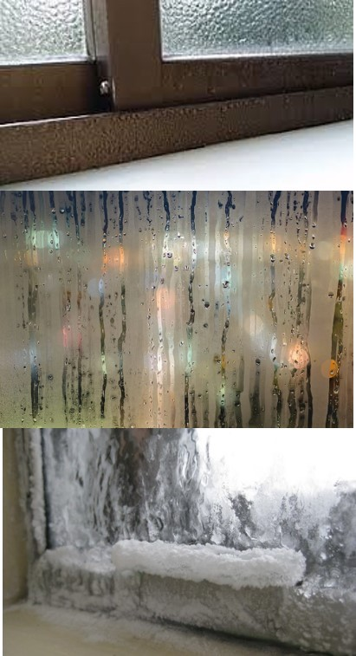
Condensation Prevention
Excess condensation can support the growth of mold and mildew and lead to bronchitis and pneumonia all of which are health risks. In cold climates it can also lead to ice build up (lower image). Designers should check the required condensation resistance factor (CRF) based on anticipated interior humidity and local climate data and select a window with an appropriate CRF. High interior humidity buildings where condensation control is even more critical require project-specific thermal modeling.
Thermally broken frames are the most effective means to resist or prevent condensation and ice accumulation. Placing the thermal barrier in a position that avoids exposing the inboard aluminum frame portion to cold air prevents cold air "short circuiting".
The Architectural Aluminum Manufacturing Association (AAMA) provides guidance and testing protocols for these issues in their AAMA 1503: Thermal Transmittance and Condensation Resistance of Windows, Doors and Glazed Wall Sections publication.

Slide 31
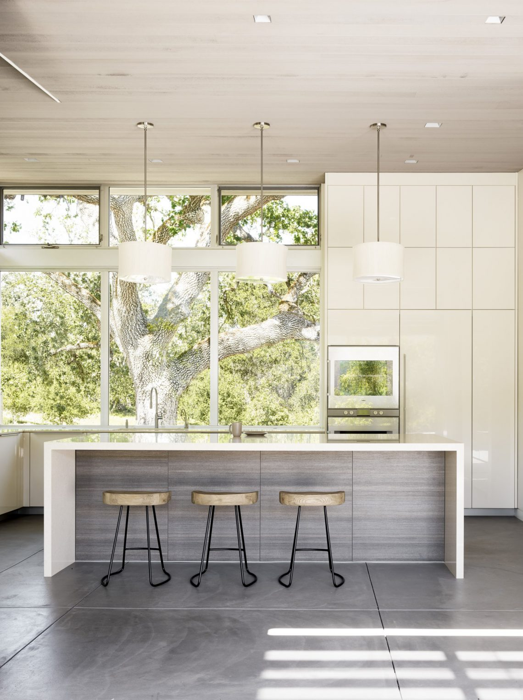
Further Considerations
Structural Strength
The strength of aluminum enables glass clad structures to meet wind load provisions of Minimum Design Loads for Buildings and Other Structures, Standard ASCE/SEI 7-10. (ASCE is the American Society of Construction Engineers.)
Daylighting
The slimmer profiles of aluminum extruded window frames increase the amount of daylight entering the window, sometimes by as much as 20%.
Acoustic Performance
External window acoustic performance is measured by the Outdoor-Indoor Class or OITC which measures the sound levels for exterior walls from outside sound sources. This performance is affected by the design of the window frame, thermal breaks, gaskets, and seals etc. inherent in all aluminum frames. Reduced sound levels reduce stress in healthcare facilities and improve productivity in workplaces.

Slide 32
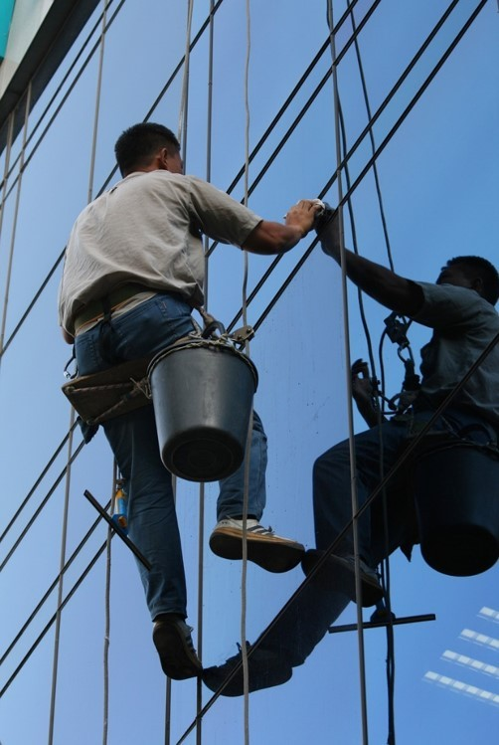
Further Considerations
Maintenance Requirements and Durability
Aluminum is not only extremely durable but it also requires minimum maintenance after installation. In general, periodic washing with soap and water is all that is required. Manufacturers can supply further information if necessary.
Receptor Frames
Receptor frames are additional framing components that encase or surround one or more window components in a similar manner to that of stud tracks which hold light-gauge metal studs in place. They are generally used to simplify window installation and save time and money. They will be discussed in more detail in the next section of the course.

Slide 33
REVIEW QUESTION
Can you recall how much of the aluminum shipped to the building industry is still in use and how much has been recycled?

Slide 34
In North America, it is estimated that at least 85% of all aluminum shipped to the construction sector is still in productive use today and 12% has been recovered and recycled.
ANSWER

Slide 35
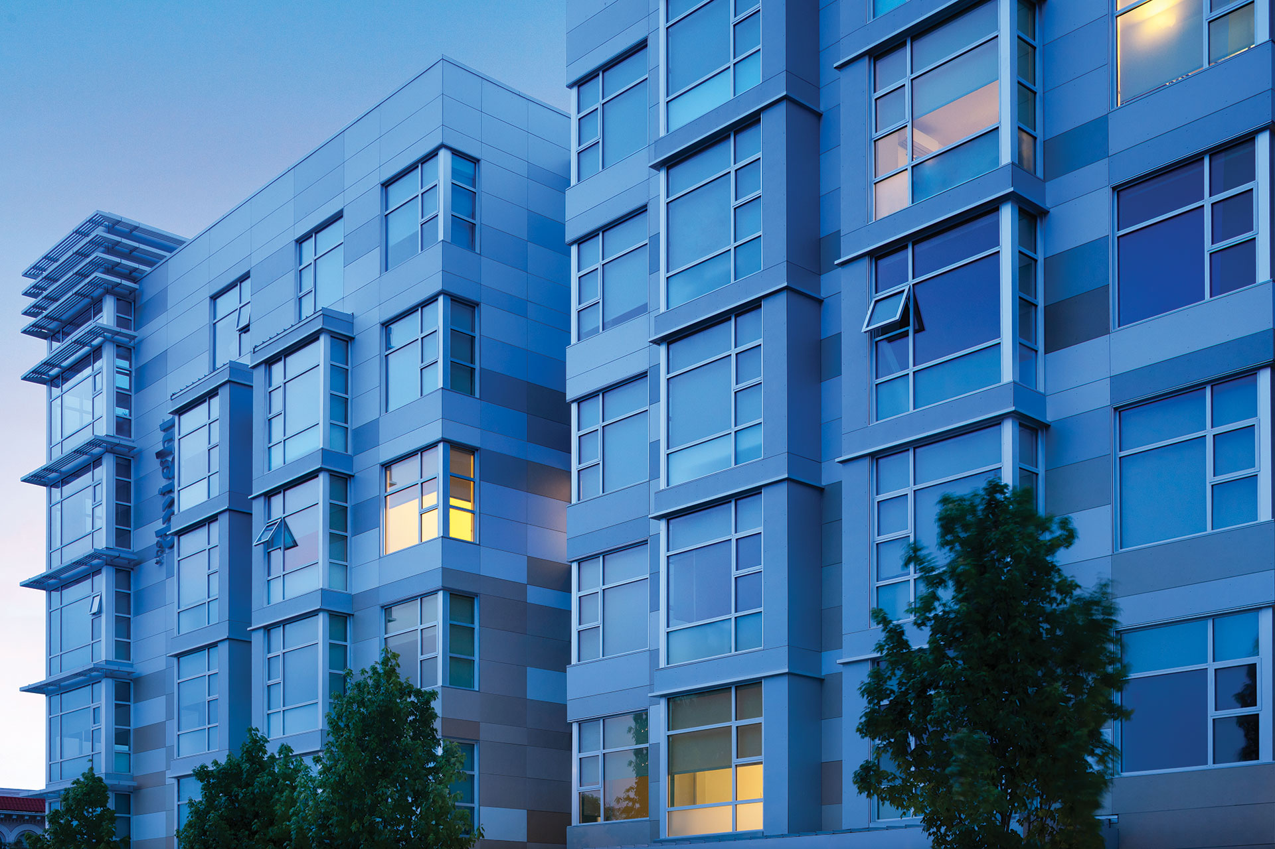
Window Performance Standards

Slide 36
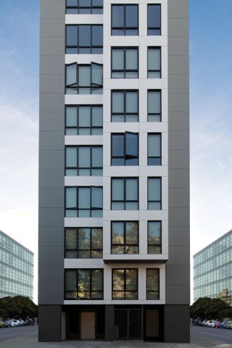
Window Performance Standards
This section explores desired performance targets, the standards that inform them, and the technologies which can be used to address and meet them.

Slide 37
Sample Performance Specification
PERFORMANCE REQUIREMENTS
A. Design pressure, air infiltration and water penetration.
  1. Comply with AAMA/WDMA/CSA 101/I.S.2/A440 [AW-PG80].
B. Uniform Load Deflection and Uniform Load Structural to ASTM E330.
C. ASTM E283, Air Leakage: 6.27 psf: 0.1 cfm/ft2 maximum.
D. ASTM E547, Water Penetration: at 12.11 psf: No leakage.
E. ASTM F588, Forced Entry Resistance: Type B Grade 10: Pass for No entry.
F. U-Value [____].
G. Solar Heat Gain Coefficient (SHGC) [____].
H. Acoustical Performance: STC [____].
The above specification ”excerpt” provides a sample condensed shopping list of performance levels that should be determined during the window design process.

Slide 38
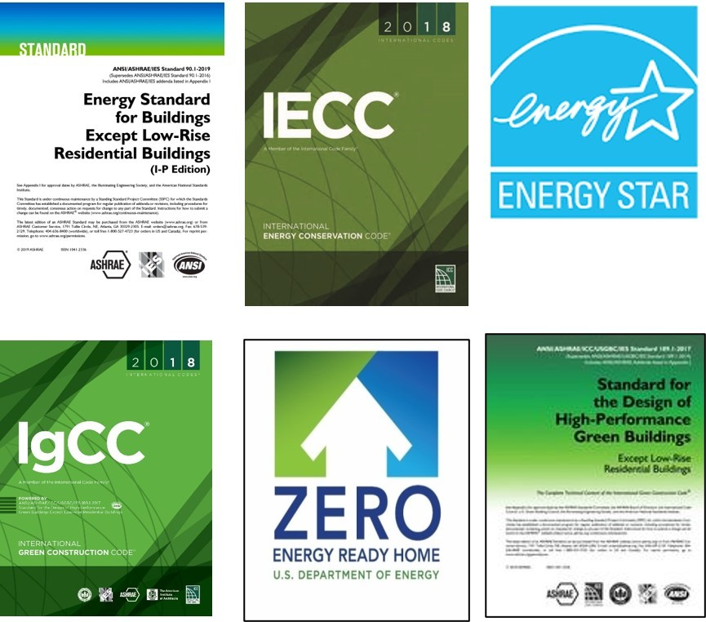
Energy Codes
Energy codes continuously reduce the amount of energy that residential and commercial buildings can use. Window design must follow this trend to become more and more energy efficient.
The primary “driving” or model codes are ASHRAE 90.1 (American Society of Heating, Refrigerating and Air-Conditioning Engineers) and the IECC (the International Energy Conservation Code). These codes must be adopted locally to have force. Other relevant codes and standards include IGCC (International Green Construction Code), ASHRAE 189.1, ENERGY STAR, and DOE Net Zero. The goal of DOE Net Zero is that 100% of all new commercial (including high rise residential) buildings will produce as much energy as they use by 2025. Window performance will be a major factor in enabling this goal and glazing techniques may include the incorporation of photo voltaics in the building cladding system.

Slide 39
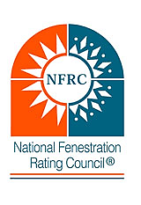
Energy Codes
U-factor, solar heat gain coefficient (SHGC), air leakage, and possibly visible transmittance are critical for compliance with any code. These properties must be provided as certified ratings determined by independent laboratories in accordance with National Fenestration Ratings Council (NFRC) standards. Air leakage ratings can be based on the North American Fenestration Standard (NAFS). The Component Modeling Approach (CMA) can generate ratings for commercial fenestration.
The CMA program of the NFRC is an online database of energy performance information for window, door, and skylight components, which offers the following:
help to non-residential manufacturers to see how changing one component can affect overall energy efficiency
information on which components can be combined, and
determination of whole product energy performance ratings for fenestration systems.

Slide 40
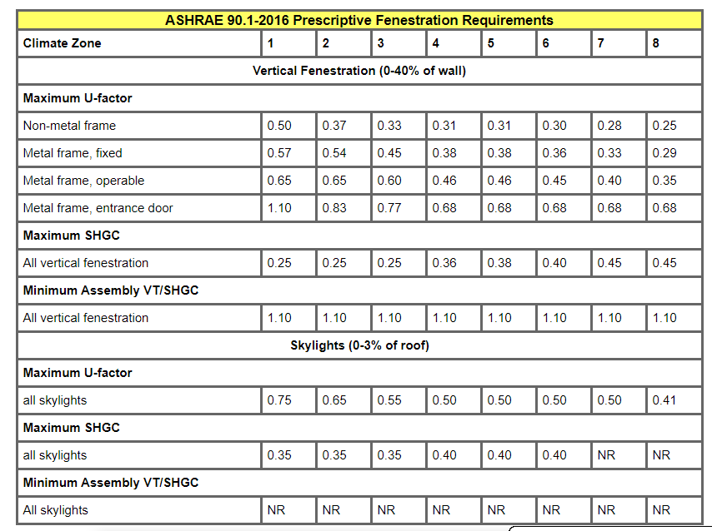
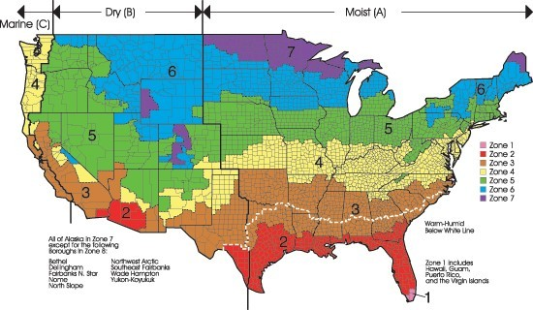
ASHRAE 2016 Energy Code
ASHRAE Standard 90.1-2016 includes a substantial reduction in allowable fenestration U-factors in all climate zones. For example a fixed window frame in climate zone 5 may only have a maximum U value of .38.

Slide 41
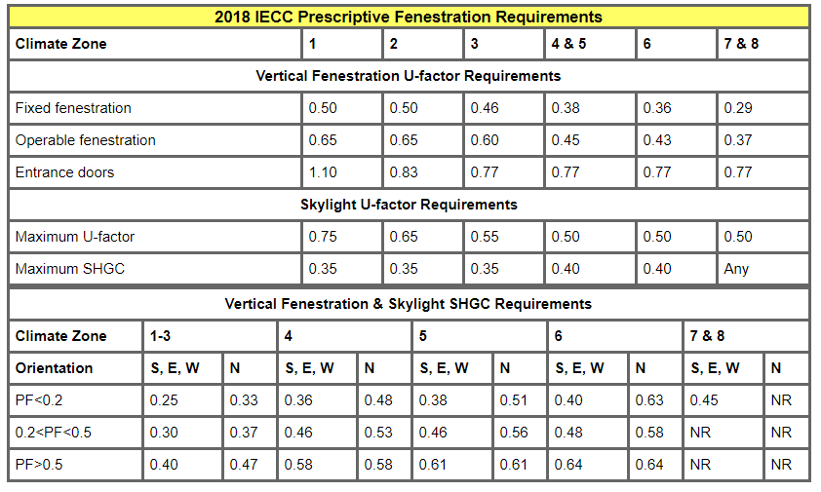
2018 IECC Energy Code
U-factors for the 2018 IECC had no significant changes from the 2012 and 2015 versions. This code also requires a U value of .38 for a fixed window in climate zone 5.
This version provides variations of the prescriptive maximum SHGC based on the size of a projected overhang and the orientation of the vertical fenestration. The 2018 IECC requires air leakage requirements of windows, doors and skylights to be in accordance with NAFS-17 or NFRC 400-17; curtainwall, storefront, and commercial doors must be in accordance with ASTM E283-04 (2012).
Aluminum windows can meet the thermal requirements of all of these codes with an increased use of thermal breaks and upgraded glazing strategies. In addition they can satisfy all daylighting requirements. Daylighting is also becoming a more important consideration as there is a steadily rising focus on occupant health and well being in building design and certification.

Slide 42
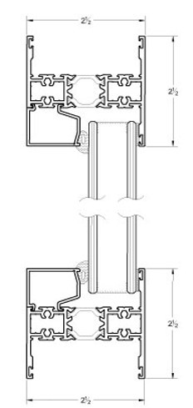
Thermal Performance of Insulated Glass Units (IGUs)
There have been recent advances in thermal barriers which meet these increasingly stringent energy reduction goals. These include polyamide struts and wide cavity, dual pour, and debridged polyurethane thermal barriers.
These types of barriers will be explained in greater detail later on in this course.
In addition, aluminum thermal barrier technology is making further advances to work more closely in conjunction with glass, glazing, and envelope materials to reduce commercial building energy consumption. Current technology with standard thermal breaks has improved aluminum frame U-factors from roughly 2.0 to about 1.0.
Innovative new thermal break designs have been combined with changes in frame design to achieve U-factors lower than 0.5, but at a higher cost than current thermally broken frames. The higher capital cost of the frames, however, can be recovered over time in energy savings.

Slide 43
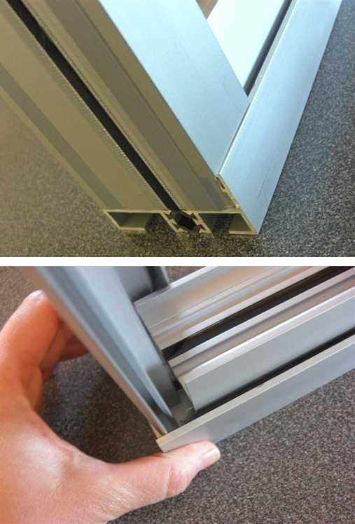
Thermal Performance of IGUs
Glazing performance can be equally, if not more, important than the frame which should then should be designed to accommodate the best glazing solution. In the the Empire State Building energy retrofit described earlier the opposite occurred. Because of the desire to retain the existing aluminum window frames which previously held double glazing with a steel spacer the retrofit glazing strategy created glazing to fit into these frames. The solution was double glazing with a high performance E coating, a suspended heat mirror film, inert gas, and warm edge spacers to double or quadruple the overall performance of the windows within the existing frame.
Double and triple pane windows are now often filled with inert gases such as argon or krypton to reduce convection within the window units and to improve the window’s overall energy efficiency. These gases are often known to leak, often at a rate of just 1% a year which is generally acceptable but sometimes if the seals are not sufficient they will leak faster, thus ruining their contribution towards energy efficiency and necessitating an expensive replacement. Aluminum can be fabricated to extremely close tolerances to create precise forms for the insertion of glazing, weatherstripping, and thermal barriers to control this leakage.

Slide 44

Glazing Options
It is not the intent of this course to provide a full analysis of each type of glazing material or system but simply to list the materials and describe them briefly to assist the designer in selecting the appropriate one.
Clear Glass
Clear glass (image) is the most commonly used type of glass. It has high visible light transmittance and reasonable color neutrality. It is widely used because of its low cost due to its use of recycled material and is an excellent substrate for high performance low-E coatings (see next slide).
Clear glass is essentially invisible.

Slide 45
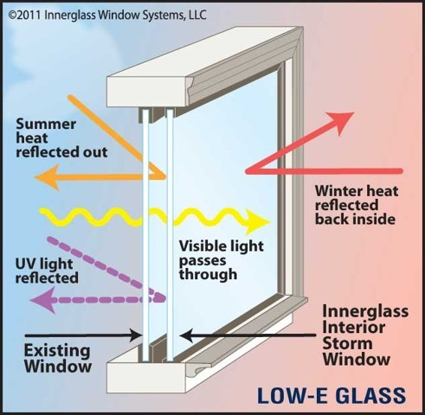
Low-E Coated Glass
Low-E (emissivity) coatings reduce heat gain from the sun and restrict the amount of ultraviolet and infrared light passing through glass without compromising the amount of visible light transmitted.
In colder climates passive coatings reflect long-wave energy from the building interior back into the building thus minimizing the amount of heat passing through it to the outside.
In hot climates low-E coated glass blocks solar heat energy and provides thermal insulation. This keeps cool air inside and hot air outside.
Maghriby2660 CC BY-SA .4.0 via wikimedia

Slide 46
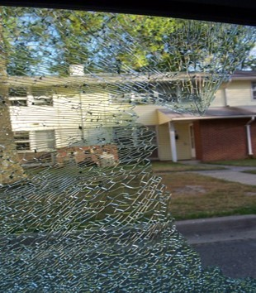
Safety Glasses
Annealed Glass (also called non-tempered, float, or standard glass).
The annealing process improves the glass’s durability and helps to reduce internal stresses that could result in breakage. Annealed glass is often used in items such as tabletops, cabinet doors, and basement windows. It is not as strong as tempered glass.
Tempered Glass
Tempered glass is annealed glass that has been heat treated to harden and strengthen it. Tempered glass is one of the hardest types of glass available. It is up to five times harder than most other glasses, including annealed glass. It cleans very easily and, if installed properly, will not augment glare or affect colors, image quality or sharpness.
Laminated Glass
This glass is one step higher as a safety glass. It is made by adhering two pieces of annealed glass together with a vinyl layer. The vinyl layer holds the glass together if the glass is broken or impaled.
If tempered glass breaks the energy developed during the annealing process is released to reveal a crystalline lattice radiating outwards from the point of impact.
Markjurrens CC BY-SA 3.0 via wikimedia

Slide 47
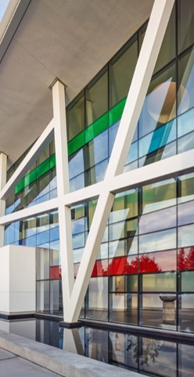
Other Glass Options
Tinted Glass
Tinted glass (image) is used to add color to projects. Tints are also beneficial for reducing glare and limiting solar heat gain when used in conjunction with low-E coatings. Tinted glass can be laminated, tempered, or heat-strengthened to satisfy strength or safety requirements.
Low-Iron Glass
Low-iron glass is made with a low-iron formulation that improves its levels of clarity, transparency, and color accuracy when compared to clear glass. This can significantly impact daylighting because it can provide the same amount of daylight in smaller areas as clear glass does in larger areas but without the same amount of heat loss/gain.
Spandrel Glass
Spandrel glass is opaque and can hide features between the floors of a building. Spandrel glass should be heat-strengthened to resist the thermal stresses associated with potential heat absorption and build-up behind it. There are various types of spandrel glass units available and they include insulated units.

Slide 48
Further Performance Factors
In relation to the window as a whole there are a number of other performance factors that the designer should assess in order to assess future performance.
U Factor: the heat transfer (heat gain or loss through glass). The lower the U factor number the better.
R Factor: the heat resistance and the performance or a material’s ability to reduce the transfer of heat. The higher the number the better.
Solar Heat Gain Coefficient: how well a product can resist heat gain. The lower the number the better.
Visible Light Transmittance: how well a product will admit natural light. The higher the number the better.
Air Leakage: how much unwanted air will enter a space through a window assembly. The lower the number the better. Less air leakage means a lower amount of drafts will be experienced and that occupant comfort and health will be improved.
Water Infiltration: how much water will infiltrate a window assembly from real life weather events, or wind-driven rain in a given amount of time. It is typically tested according to ASTM E 1105.
Window Area: the total viewing area available in any window which affects daylighting, view, and energy performance as well as building aesthetics.

Slide 49
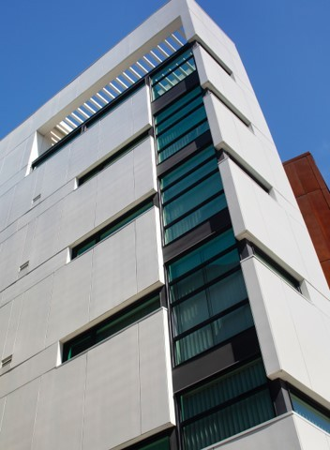
Further Performance Factors
  Structural ratings are comprised of two parts: deflection measurements and overload pressure.
  Deflection is measured by loading the window to the design pressure and the amount of deflection at the center of the mullion is measured under wind loading.
  Overload pressure: Once the first portion of structural testing is complete, overload testing to 1.5 times the design pressure is done. The window must still stay intact without major deformation and be in working condition after testing is complete.
  Aluminum maintains its original structural integrity over a long service life and even becomes stronger in extremely cold temperatures. Extruded aluminum building components also resist deformation caused by climate changes and building movement and retain their basic structure, strength, stability, and durability, and preserve their resistance to water and air infiltration.

Slide 50
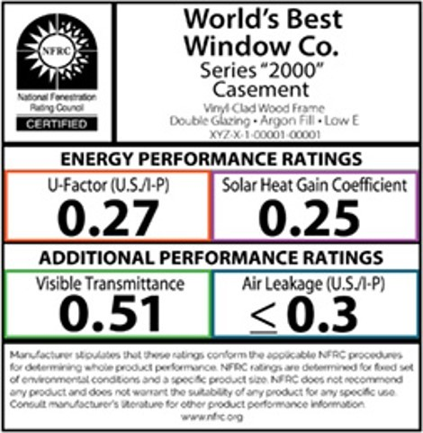
Further Performance Factors
NFRC (National Fenestration Rating Council) Labels (image) help compare energy-efficient products by breaking down a product’s energy performance into multiple categories such as those illustrated on the label.
NAFS (North American Fenestration Standard) is a fenestration standard based on the Design Pressure (DP) concept. It defines basic performance requirements for a wide variety of styles of window, door, and skylight products including those with aluminum or vinyl cladding. It relies on performance class and performance grade designations to guide this evaluation and selection process. Its four performance classes are “R” ( Residential), “LC” ( Light Commercial), CW (commercial), and “AW” (Architectural)

Slide 51

Further Performance Factors
Wildfire Zones
The prime factor related to fire s the glazing but non-combustible aluminum frames hold the glazing longer than many other framing materials. Double glazing provides better protection over single glazing and tempered glass which is 4 times as strong (resistant) as single pane annealed and 2 times that of a dual pane increases the fire resistance further.
The California Building Code requires multipane glazing with at least one pane to be tempered and the window to be 20 min. rated. Rated systems must have rated glazing and frames and survive the hose stream test NFPA 257.
They must also meet SFM (Sustainable Forest Management) standard 12-7A -2 which says “exterior windows must meet a fire resistance test standard consisting of a 150 kW intensity direct flame exposure for an 8-minute duration”.
Fire protective glass prevents the spread of fire and smoke but not heat transfer. When the glass heats up on one side, objects on the other side of the glass will feel the heat.
Fire-resistive glass prevents the spread of fire and smoke and also stops radiant and conductive heat transfer. Objects on the protected side do not get hot enough to spontaneously combust. This is usually accomplished with a laminated assembly composed of multiple glass layers separated by heat resistant interlayers.
In addition creating standard extrusions for windows and doors the aluminum extrusion process is ideal for custom solutions because tooling costs and lead-times for aluminum extrusion tooling are usually substantially less than for other processes (e.g. a few weeks vs. 12–20 weeks for alternatives).
Custom extrusions can create unique design solutions for unique circumstances when necessary or desired.
With custom extrusions, a designer does not choose from a set of standard but they actually create the shape they need to meet the desired aesthetic and functional requirements of the project. The extrusion process provides the unique ability to create solid or hollow shapes that put metal precisely where it should be to meet all these requirements. Tight tolerances, even on thin-walled extrusions, can be consistently maintained.
Extrusions are available in a variety of alloys and tempers. Certain alloys are stronger, have greater conductivity, or other functionality etc. but for most construction applications, 6000‐series alloys are ideal.

Slide 52
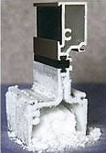
Thermally Improved Extrusions
Roughly half of the current improvement to U factors comes from recent improvements to thermal barriers. There are two principal types of thermal barriers: polyurethane poured and debridged, and polyamide insulating strut.
The poured-and-debridged method (image) involves pouring a polyurethane-based mixture into the thermal break channel of an aluminum extrusion. Once it cures the barrier channel is debridged which means the metal bridge from the bottom of the channel is removed to produce a structural thermal barrier between the metal surfaces.
These systems are available in either single or double poured and debridged thermal barriers in the same aluminum extrusion. They provide a range of products to complement the glass selected, and to meet specific project performance and budget needs.
While this is the older method it is still in widespread use. Its disadvantage is that the thermal barrier width is typically limited to about 0.25 in.(6.35mm.) by the structural requirements, and the thickness of the thermal barrier is fairly large, thus limiting its effectiveness. Windows incorporating this type of thermal barrier have a general performance of about U = 0.5 Btu/(hr·ft²·°F), or R2.

Slide 53
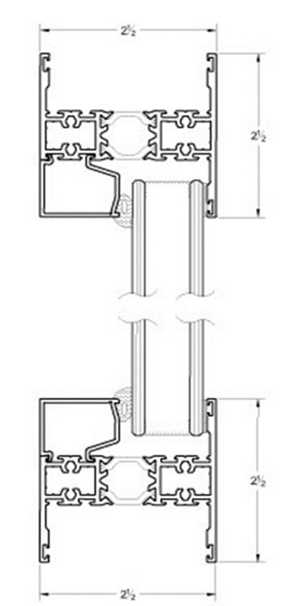

Thermally Improved Extrusions
The insulating strut method (images) involves placing pre-extruded polyamide strips into the thermal break pockets of two separate, inner and outer, aluminum extrusions. After the strut is inserted, the aluminum framing member is crimped or rolled, to mechanically lock the barrier in place and form a bond between the two extrusions and the insulating strip to create a structurally secure assembly. While polyamide has higher conductivity than polyurethane, these strips are thinner and can have larger widths than pour-and-debridged systems (normally around 0.50 in. or 12mm.), which allows for better frame performance of about U = 0.35 to 0.4.
The NFRC designates thermal barriers into two basic categories.
  A thermally-improved member enhances efficiency but which may not provide the highest energy efficiency available.
  A thermally-broken member gains further energy efficiency.

Slide 54
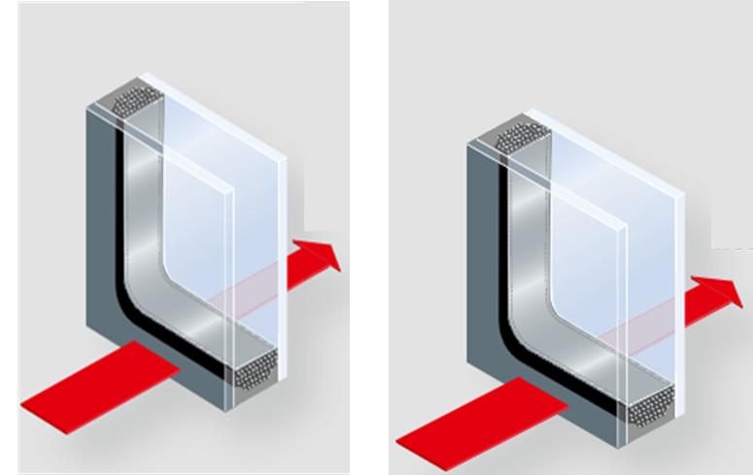
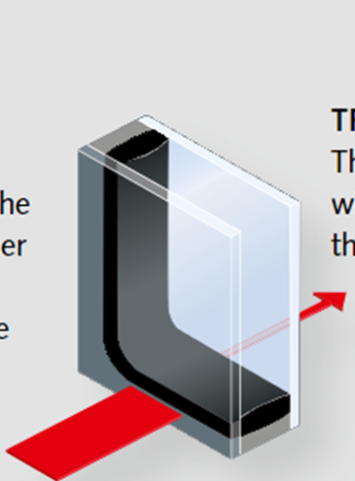
Warm Edge Spacers
“Warm edge” spacers are built with materials whose coefficient of linear thermal conductivity is significantly lower than an aluminum spacer bar.
They contribute to improving the performance of the window by reducing the thermal bridges at the glass perimeter. Various kinds of materials are used; flexible foams, thermoplastics, plastic/metal hybrids, and stainless steel.
They can be classified as flexible spacers, plastic/metal hybrid spacers, and stainless steel. Their benefits include energy savings, lower CO2 emissions, reduction of surface condensation on insulating glass, reduced risks of mold on the frames, and warmer contact surfaces of the window.
The left hand image shows a traditional steel spacer and the right hand one shows a warm edge spacer.

Slide 55
Receptor Frames
Receptor frames contain and drain water infiltrating the enclosed window assembly and the joints between the window and the receptor frame itself. They should incorporate mechanically-attached metal end dams or end caps to prevent water from draining off the ends of the sub-sill into the building (or underlying flashing system) and they should be sealed to jamb receptors (if provided) so that water traveling down the jamb is directed into the sub-sill and out its weep holes.
Receptor frames can be used to accommodate a limited amount of structural deflection; the nesting nature of the receptor frame can allow a small amount of slab deflection without transferring loads to the window units themselves. They are often used to compensate for variations of levelness and squareness in the field.
Because they are usually field assembled and thus not fabricated with the same precision as factory created window components they often rely on sealants to make them secure from water and air penetration. They can also create a continuous air loop around the window and cause convection currents resulting in increased air leakage and condensation and, if poorly fabricated, they can also increase water penetration. Receptor frames are normally not tested in the field as the window units themselves are.

Slide 56
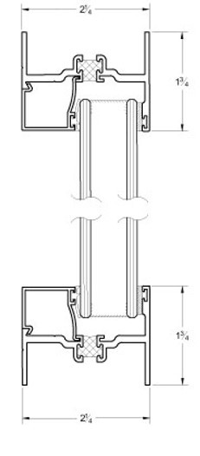
Compensation Channels
These are special extrusions that help the building achieve special design and performance criteria. They are separate frame components that allow the windows to be installed at a depth or forward to exterior.

Slide 57
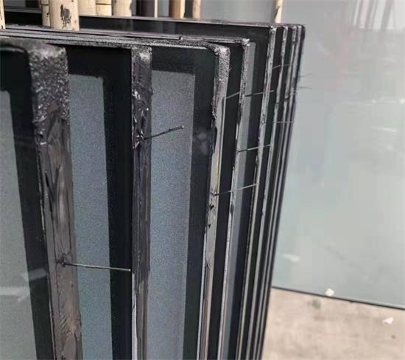
Capillary and Breather Tubes
Capillary tubes (image) and breather tubes are used in insulating glass units to equalize the pressure between the sealed panes. They are used primary for installation of windows at high altitudes.
Breather tubes are aluminum tubes with an inside diameter of approximately 0.125″ (3mm.) and a typical length of 3 to 6 ″ (76 to 150mm.). They are sealed after pressure equalization at the installed altitude.
Capillary tubes are small stainless steel or aluminum tubes with a typical inside diameter of 0.10 to 0.020″ (2.5 to 5mm.), and a typical length of 12″ (300mm.) Capillary tubes are typically left open in the field, to allow the IGU to equalize initially and then maintain a generally flat appearance over time.

Slide 58

REVIEW QUESTION
How many of the beneficial attributes of aluminum can you recall?

Slide 59
Aluminum is lightweight and strong, corrosion resistant, flexible, reflective, impermeable, durable, non toxic, safe, non magnetic, a thermal barrier and conductor, and electrically conductive.
ANSWER

Slide 60
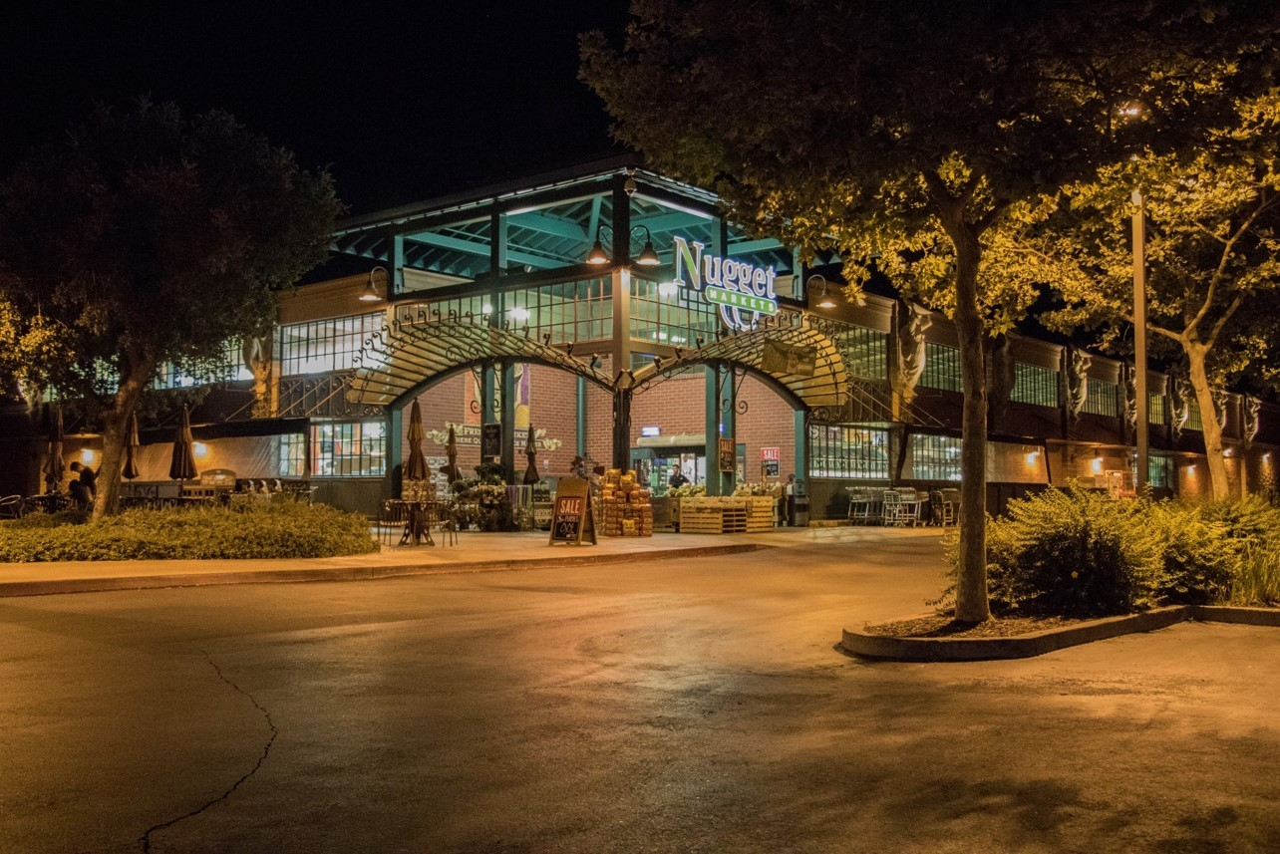
Environmental Product Declarations (EPDs) and Green Building Certification

Slide 61
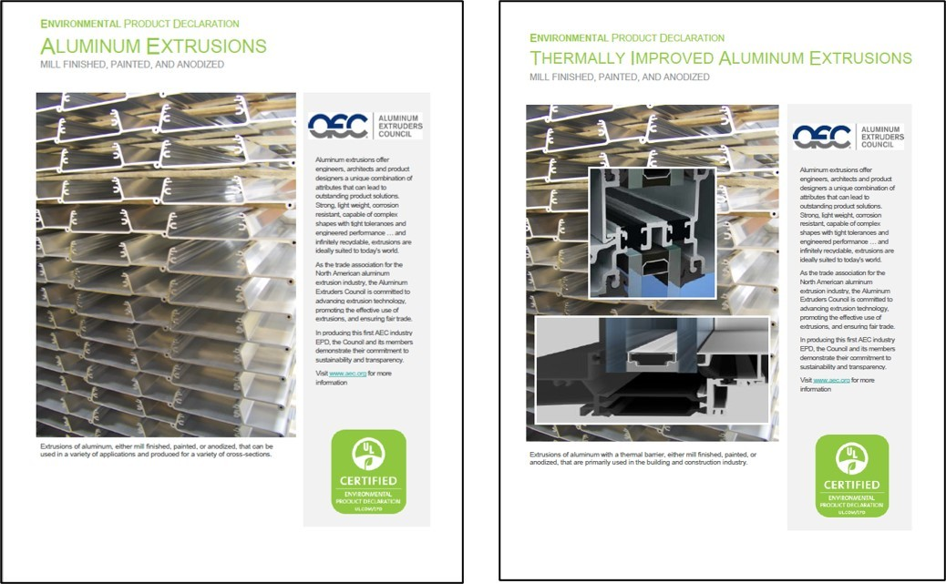
Environmental Product Declarations (EPDs)
EPDs and Green Building Certification
An EPD is an independently verified and registered document that communicates transparent information about the life cycle environmental impacts of a product. In 2016 the AEC (Aluminum Extrusion Council) released two EPDs for aluminum extrusions; one for basic extrusions and one for thermally improved ones. They can be accessed here. These are comprehensive documents which cover all aspects of aluminum extrusion production.
EPDs are preceeded by LCAs whose basic findings were outlined earlier.

Slide 62
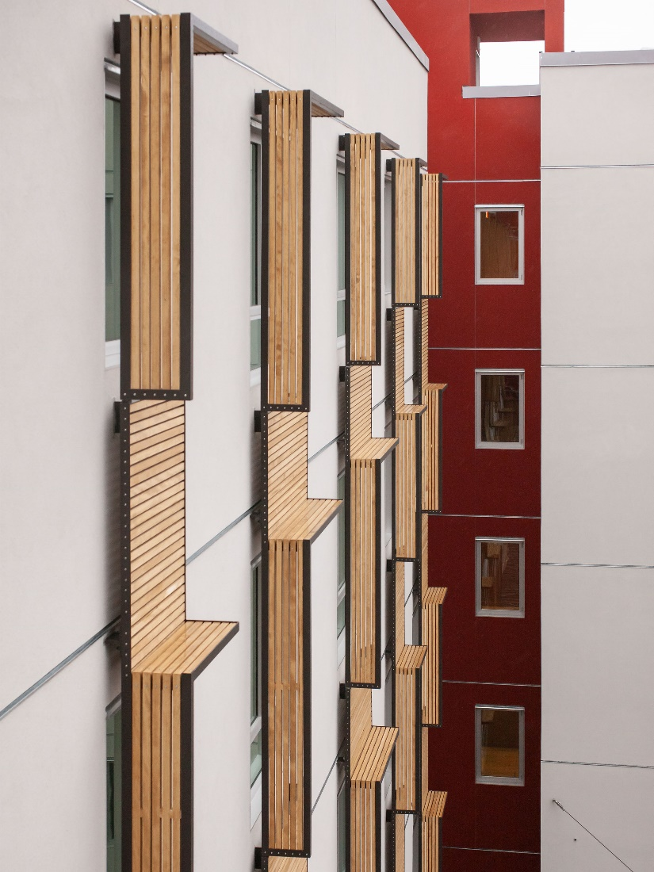
Green Building Certification
Aluminum fenestration systems can contribute to green building certification and third-party rating programs in a number of areas, including: energy-efficiency, material sustainability, and indoor environmental quality. The use of aluminum extrusions allows architects to meet the challenges of sustainable design and provides many benefits to the “whole building design” concept.
Aluminum-framed products meet thermal performance requirements with increased use of thermal barriers, low-E glass, and triple glazing. Aluminum windows help satisfy daylighting requirements, aluminum sunshades (image) help meet shading requirements, and aluminum products contribute to the sustainable material requirements.
Photo courtesy of vmwp architects and urbam desgners and keith baker photography

Slide 63


The LEED Program
The LEED (Leadership in Energy and Environmental Design) green building certification program, developed by the USGBC (US Green Building Council) is considered the national benchmark for the design, construction, and operation of high performance green buildings.
LEED credit requirements cover the performance of materials as a whole and do not assess the performance of individual products or brands. Specific products or materials can only contribute toward earning LEED certification points; they cannot earn points individually themselves.
It is important to remember that green building codes and programs now look at the overall interior environmental quality (IEQ) of a building in addition to energy efficiency and other issues; this includes the benefits of daylighting and views to building occupants.

Slide 64
LEED Credits
One applicable example credit is Materials & Resources Building Product Disclosure and Optimization which contains :
* Environmental Product Declarations (possible 2 points)
Sourcing of Raw Materials (possible 2 points) The intent of this credit is: To encourage the use of products and materials for which life cycle information is available and that have environmentally, economically, and socially preferable life cycle impacts. To reward project teams for selecting products verified to have been extracted or sourced in a responsible manner.
Material Ingredients (possible 2 points) The intent here is: To encourage the use of products and materials for which life-cycle information is available and that have environmentally, economically, and socially preferable life-cycle impacts. To reward project teams for selecting products for which the chemical ingredients in the product are inventoried using an accepted methodology and for selecting products verified to minimize the use and generation of harmful substances. To reward raw material manufacturers who produce products verified to have improved life-cycle impacts.
It is easy to see how the positive attributes of aluminum windows can contribute to credits in these categories.
*The method of achieving this credit is outlined on the following slides.
.

Slide 65
Achieving the Environmental Product Disclosure Credit
The intent of this credit is: To encourage the use of products and materials for which life-cycle information is available and that have environmentally, economically, and socially preferable life-cycle impacts. To reward project teams for selecting products from manufacturers who have verified improved environmental life-cycle impacts.
The requirements for this credit are:
Option 1. Environmental Product Declaration (EPD) (1 point)
Use at least 20 different permanently installed products sourced from at least five different manufacturers that meet one of the disclosure criteria below. (10 different permanently installed products from three different manufacturers for CS and Warehouses & Distribution Centers).
LCAs and EPDs
Products with a publicly available, critically reviewed LCA conforming to ISO 14044 that have at least a cradle to gate scope are valued as one whole product for the purposes of credit achievement calculation.
Product-specific Type III EPD -- Internally Reviewed. Products with an internally critically reviewed LCA in accordance with ISO 14071. Products with product-specific internal EPDs which conform to ISO 14025, and EN 15804 or ISO 21930 and have at least a cradle to gate scope are valued as one whole product for the purposes of credit achievement calculation. continued ……

Slide 66
Environmental Product Disclosures
Industry-wide Type III EPD -- Products with third-party certification (Type III), including external verification in which the manufacturer is explicitly recognized as a participant by the program operator. Products with industry-wide EPDs, which conform to ISO 14025, and EN 15804 or ISO 21930 and have at least a cradle to gate scope are valued as one whole product for the purposes of credit achievement calculation.
EPDs which conform to ISO 14025 and EN 15804 or ISO 21930 and have at least a cradle to gate scope.
.Product-specific Type III EPD -- Products with third-party certification (Type III), including external verification and external critical review in which the manufacturer is explicitly recognized as the participant by the program operator are valued as 1.5 products for the purposes of credit achievement calculation.
USGBC approved program – Products that comply with other USGBC approved environmental product declaration frameworks.
The credit also outlines another option which uses LCAs. As noted on previous slides the industry has conductedboth LCAs and EPDs.
Please remember the test password BARRIER. You will be required to enter it in order to proceed with the online test.

Slide 67
Further Credit Categories
There are a number of other credit categories where aluminum windows can contribute.
These include:
Minimum Energy Performance: a prerequisite
Optimize Energy Performance: a possible 20 points
Construction and Demolition Waste Management Planning: a prerequisite
Building Life Cycle Impact Reduction
Credits for acoustic control, indoor air quality, daylighting, and quality views.
The full LEED building and design and construction category is described at http://build.usgbc.org/bdc41

Slide 68
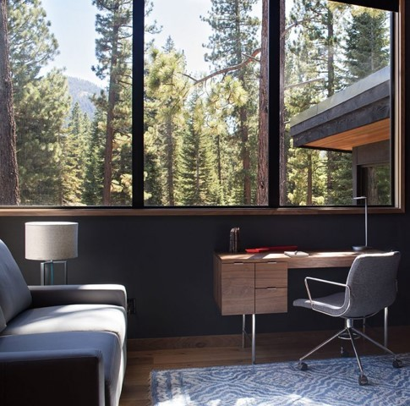
Further Accreditations
Many of the issues identified by LEED for credits are recognized by other building standards as well.
The International WELL Building Institute™ (IWBI™) is a public benefit corporation whose mission is to improve human health and well-being in buildings and communities across the world through its WELL Building Standard™ (WELL™).
This standard also recognizes the importance of enhanced daylight access and requires projects to design spaces to integrate daylight into indoor environments in order that daylight could be used for visual tasks along with electric lighting and to provide windows that connect individuals to the outdoors with views.

Slide 69
Name the various natural and man-made finishes for aluminum.
REVIEW QUESTION

Slide 70
Aluminum instantly forms a tenacious oxide film but when additional finishing is desired anodizing or paint (either liquid or powder) is typically specified. In some cases mechanical finishing, such as brushing or sand‐blasting, is employed.
ANSWER

Slide 71
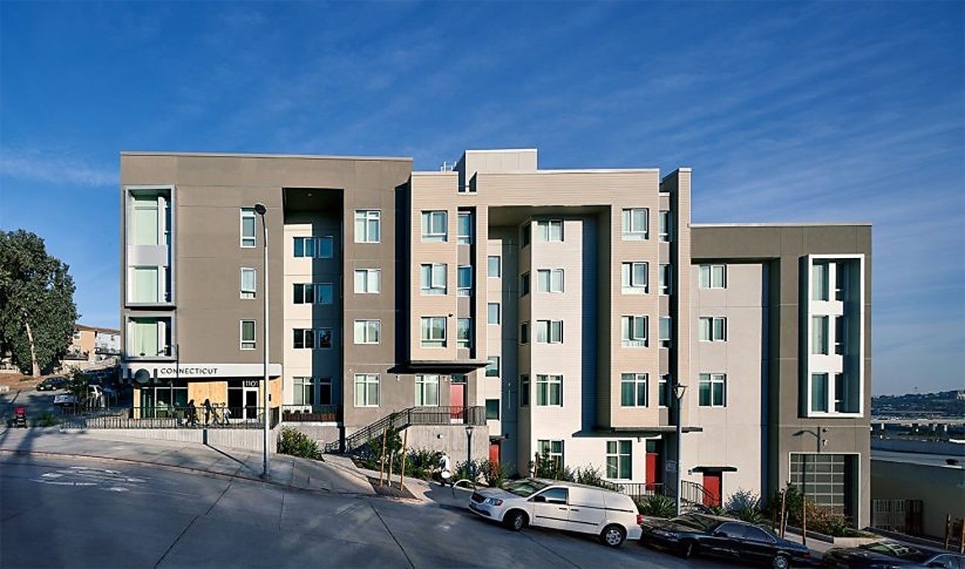
Case Study: 1101 Connecticut St. San Francisco
All photos courtesy of vmwp architects and urban designers and keith baker photography

Slide 72

1101 Connecticut St.
1101 Connecticut is a 72-unit affordable housing project consisting of studio, one, two, and three bedroom apartments. It is the initial building of a 36 acre (14.5 Ha.), 1700 unit LEED ND mixed income redevelopment of Potrero Hill in San Francisco.
The IDP (integrated design process) process was utilized to develop an optimum envelope before addressing the internal loads. This required multiple versions of energy modelling to find an affordable yet compliant solution that would avoid the necessity of air conditioning systems. Affordable housing developers prioritize energy efficiency, reduced energy costs, durability, and low maintenance materials

Slide 73
1101 Connecticut St.
The IDP involved many parties including the housing authority, the developer, the architects and their consultants, as well as neighborhood residents, some of whom were future tenants.
The involvement of future residents identified a number of important issues and special needs that the building should address and one of those was a high level of indoor air quality. The window performance in relation to controlling air leakage became critical in ensuring that the selected mechanical ventilation system would perform as intended.
Although the original goal was to achieve LEED gold the building achieved LEED platinum with very little extra effort and now has established an excellent functional and aesthetic benchmark for all the other buildings which will follow it over the next decade.

Slide 74

1101 Connecticut St.
The creation of the high performance envelope involved the development of two custom panning extrusions which extended out far enough to accommodate an extra 1.5″ (38mm.) of insulation that, in turn, eliminated the need for a more expensive hydronic heating solution.
Quite often upgrading the glazing system, especially at the beginning of the design phase before mechanical systems are selected, more than pays for itself in both reduced initial mechanical costs and even more so over the long term in energy savings.

Slide 75

1101 Connecticut
A free standing mockup allowed the installers to demonstrate their understanding of the window installation details and to refine the details for the variety of conditions. This mockup plus several windows were tested for water penetration.

Slide 76

1101 Connecticut
As noted, the building received LEED Platinum certification for implementing practical and measurable strategies and solutions in areas including sustainable site development, water savings, energy efficiency, energy efficient appliances, drought tolerant landscaping, recycled low VOC materials, bicycle parking, and indoor environmental quality.
The building includes excellent solar orientation, solar thermal and photovoltaic panels, a centralized filtered air distribution system, on-site stormwater capture and management, and a range of healthy and environmentally preferable materials.
Achieving LEED Platinum was the result of good design.

Slide 77
1101 Connecticut St. Window Performance Requirements
This excerpt from the project specification illustrates some of the standards for window performance.
A. Product Standard: Comply with AAMA/WDMA/CSA 101/I.S.2/A440 for definitions and
minimum standards of performance, materials, components, accessories, and fabrication
unless more stringent requirements are indicated.
1. Window Certification: AMMA certified with label attached to each window.
B. Performance Class and Grade: AAMA/WDMA/CSA 101/I.S.2/A440 as follows:
1. Minimum Performance Class and Grade:
a. Fixed Windows: FW-AW80.
b. Operable Windows: C-AW80.
C. Thermal Transmittance (U-factor): NFRC 100 maximum whole-window U-factor as required
per envelope energy requirements in Drawings.
D. Solar Heat-Gain Coefficient (SHGC): NFRC 200 maximum whole-window SHGC as required per
envelope energy requirements in Drawings.
E. Visible Light Transmission (VT): As required per envelope energy requirements in Drawings.

Slide 78

1101 Connecticut St. Window Performance Requirements
F, Thermal Movements: Provide aluminum windows, including anchorage, that allow for thermal
movements resulting from the following maximum change (range) in ambient and surface
temperatures by preventing buckling, opening of joints, overstressing of components, failure
of joint sealants, failure of connections, and other detrimental effects. Base engineering
calculation on surface temperatures of materials due to both solar heat gain and
nighttime-sky heat loss.

Slide 79


1101 Connecticut St.
Neither daylight nor public and private views nor building appearance were compromised in achieving the high level of building envelope performance required to reach LEED platinum.

Slide 80

Summary and Resources

Slide 81
Summary
Aluminum has been in use for many decades in many ways and in that time has proven to be an extremely versatile and reliable building material. During the period between its early production in 1887 and today, the means by which it’s raw materials are extracted from the earth, the methodologies by which they are combined, and the manner in which aluminum products are produced has improved significantly in relation to environmental protection, emissions, the amount of recycled material used and the reduction of energy needed.
The aluminum window industry has concurrently improved the technology used to fabricate window frame extrusions. Current extrusion advancements have improved their resistance to heat loss or gain to the point where aluminum is now a top performer for window frames that must meet the increasingly stringent energy usage requirements for today’s buildings.
The positive attributes of aluminum which include strength, stiffness, flexibility, durability, corrosion resistance, and non toxicity, combined with its ability to be recycled and reused indefinitely without a loss of any of these attributes, makes aluminum one of the most sustainable and beneficial building materials in current use.
Aluminum can be finished and colored in a number of ways and thus provides designers with an extremely wide choice of design options along with the knowledge they are using a safe, affordable, healthy, and sustainable material.

Slide 82
Resources
“All About Aluminum,” UC RUSAL, n.d., https://www.aluminiumleader.com/history/industry_history/. Accessed June 2020
Alter, Lloyd. “Is Recycling Aluminum Sustainable and Green?”, Treehugger, Oct. 2018,
https://www.treehugger.com/recycling-aluminum-good-thing-right-4857598. Accessed June 2020.
.
“Aluminum 101.” The Aluminum Association, n.d., https://www.aluminum.org/aluminum-advantage/aluminum-101. Accessed June 2020.
“Aluminum Properties.” The Australian Aluminum Council Ltd. n.d., http://aluminium.org.au/aluminium/properties/. Accessed June 2020.
“Aluminum Sustainability.” The Aluminum Association, n.d., https://www.aluminum.org/aluminum-sustainability. Accessed June 2020.
“Building and Construction.” The Aluminum Association, n.d., https://www.aluminum.org/product-markets/building-construction. Accessed June 2020.
“Experience the Benefits of Aluminum in Green Architecture.” The International Aluminum Institute, n.d., http://greenbuilding.world-aluminium.org/home/. Accessed June 2020.

Slide 83
Resources
“How Aluminum Changed Architecture.” Raynears Aluminum, n.d., https://www.reynaers.com/en/how-aluminium-changed-architecture. Accessed June 2020.
“Measuring Performance: U Factor.” Efficient Windows Collaborative, n.d., https://www.efficientwindows.org/ufactor.php. Accessed June 2020.
Milne Geoff, and Chris Reardon. “Embodied Energy.” Your Home, 2013, https://www.yourhome.gov.au/materials/embodied-energy. Accessed June 2020.
Windows for High-performance Commercial Buildings, 2020 Efficient Windows Collaborative, n.d., https://www.commercialwindows.org/energy.php. Accessed June 2020.
“Window Types and Technologies.” Energy Saver, Enegry.gov., n.d.,
https://www.energy.gov/energysaver/window-types-and-technologies. Accessed June 2020.

Slide 84
Conclusion
If you desire AIA/CES, state licensing or CE credits for another organization, please click on the button to commence your online test. A score of 80% or better will allow you to print your Certificate of Completion; you may also go to your AEC Daily Transcript to see your completed courses and certificates.
For additional knowledge and post-seminar assistance, click on the Ask an Expert link.
If you have colleagues that might benefit from this seminar, please let them know. Feel free to revisit the AEC Daily website to download additional programs.
©2020 All Weather Architectural Aluminum. The material contained in this course was researched, assembled, and produced by All Weather Architectural Aluminum and remains its property. Questions or concerns about the content of this course should be directed to the program instructor. This multimedia product is the copyright of AEC Daily.
Questions? Ask an Expert – click here
MORE
Click Here to Take the Test
powered by
Exit

